Slide 1
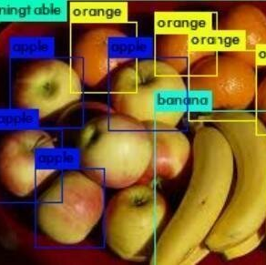
Food Freshness Detection Agent: A Hybrid Approach Using Computer Vision and Machine Learning
Gayaetiri Chalasani Cuicui Zhang
Jinyu Liu Yashwanth Chiluka

Slide 2
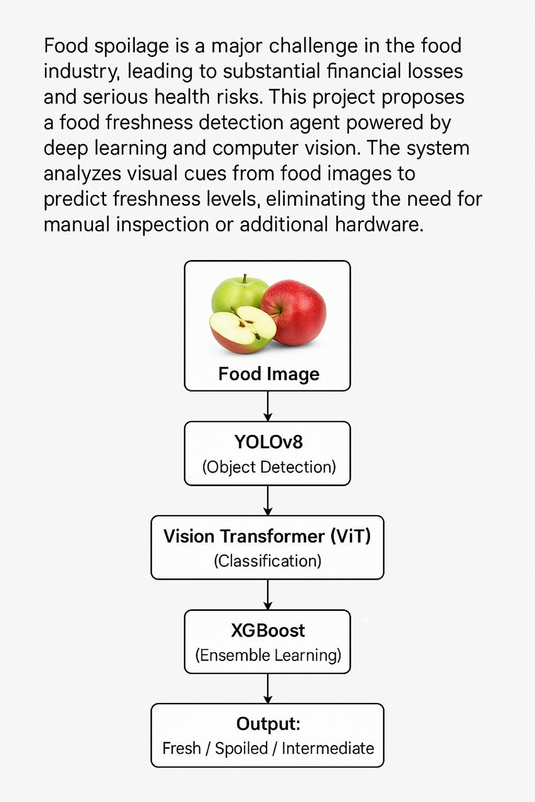
Problem Statement

Slide 3
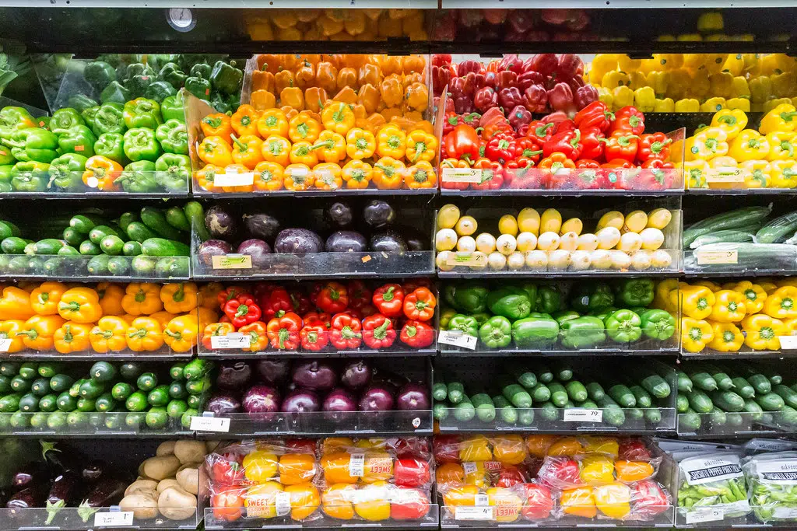
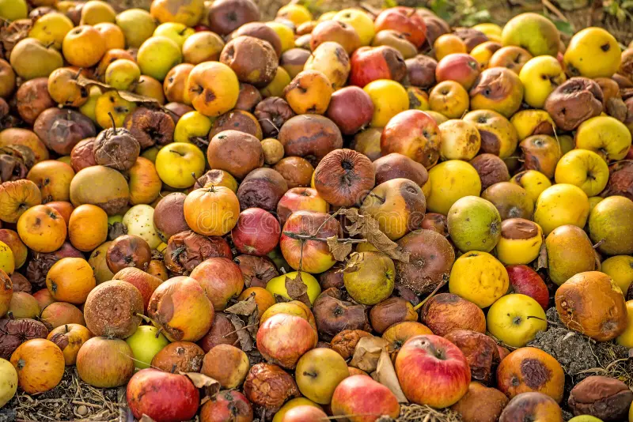
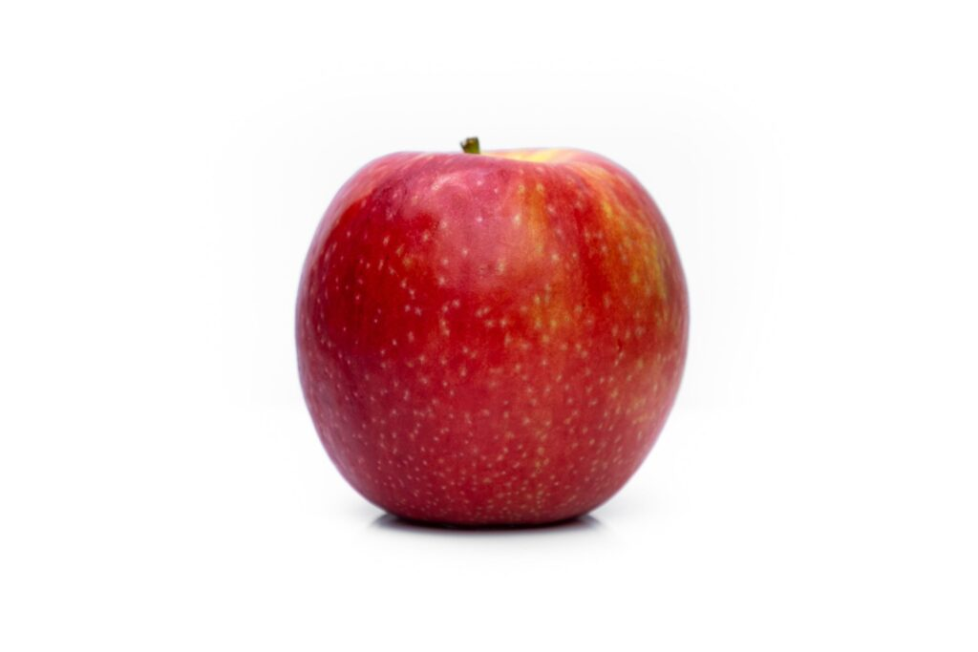
Motivation
Traditional with Background
Only Object

Slide 4
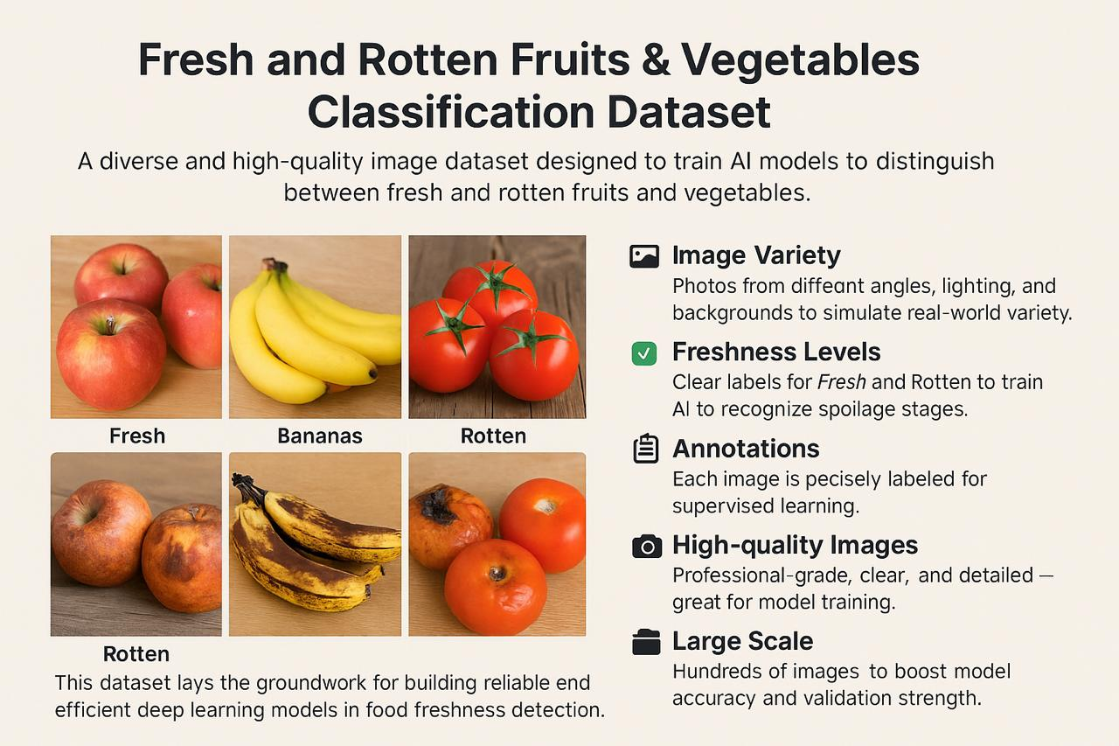

Slide 5
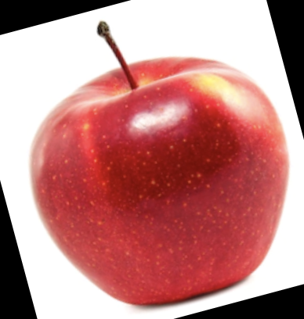
Methodology
Input image(RGB)
Cropped Output
Yolov8
(Object detection)
ViT (Classification)
Classification Probability
Confidence Score
XGBoost (improve classification)
Output

Slide 6
YOLOv8 – Object Detection
Bounding box Prediction
Anchor Based Prediction
multi-scale feature maps
Confidence Loss
Input Img
Detection Head
Localization Loss
Feature Extraction
Semetics and Spacial Features
CSPDarknet53
BackBone Network
Neck
PAnet

Slide 7

Visual Transformer
Source: lucidrains/vit-pytorch

Slide 8
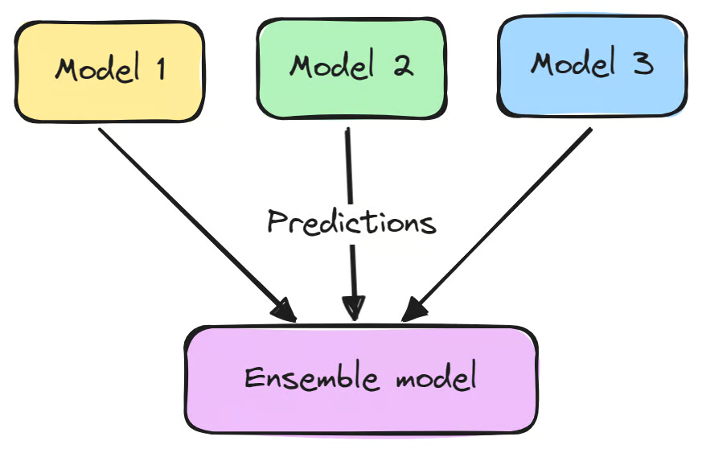
Ensemble Learning
YOLOv8
ViT
Confidence score (object detection)
Classification score
XGBoost
Output

Slide 9
Evaluation Metrics
Model | Accuracy | Precision | Recall | F1-Score
YOLOv8 | 0.79 | 0.78 | 0.76 | 0.77
ViT | 0.85 | 0.84 | 0.85 | 0.84
Fusion | 0.94 | 0.94 | 0.92 | 0.94

Slide 10
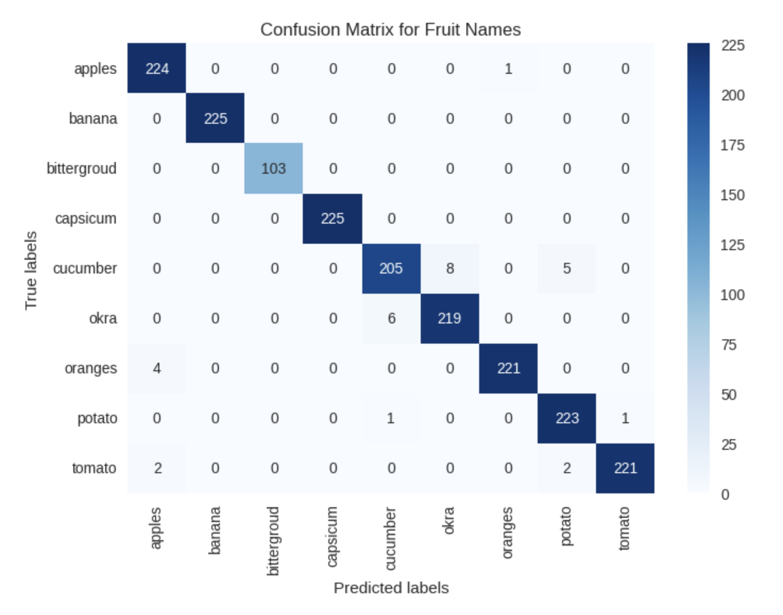
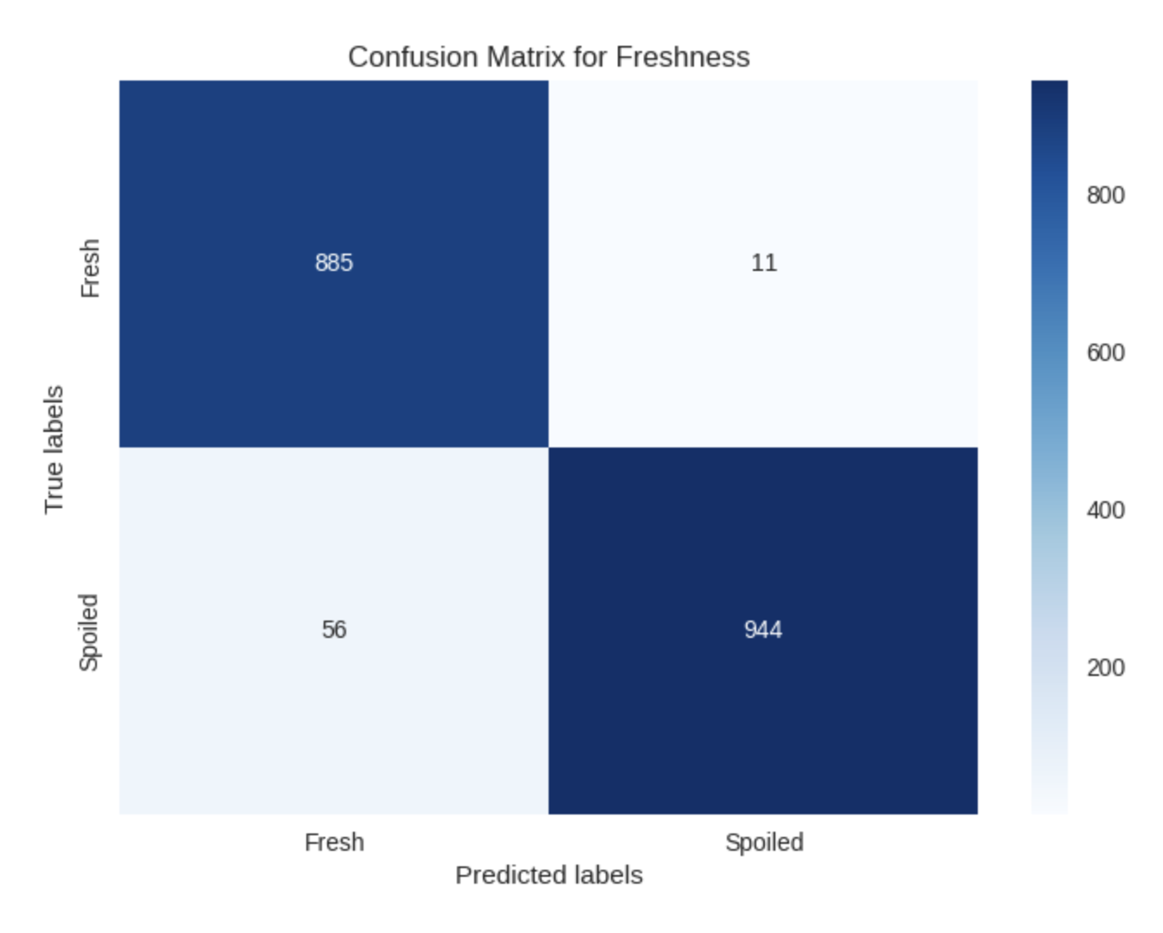
Results & Visualizations

Slide 11
Ablation Study
Model Setup | Components Used | Accuracy
Baseline ViT | Vision Transformer (ViT) only | 81.3%
YOLO + ViT Conf | ViT + YOLOv8 confidence scores | 87.2%
Full Fusion | YOLOv8 + ViT + XGBoost | 94.2%

Slide 12
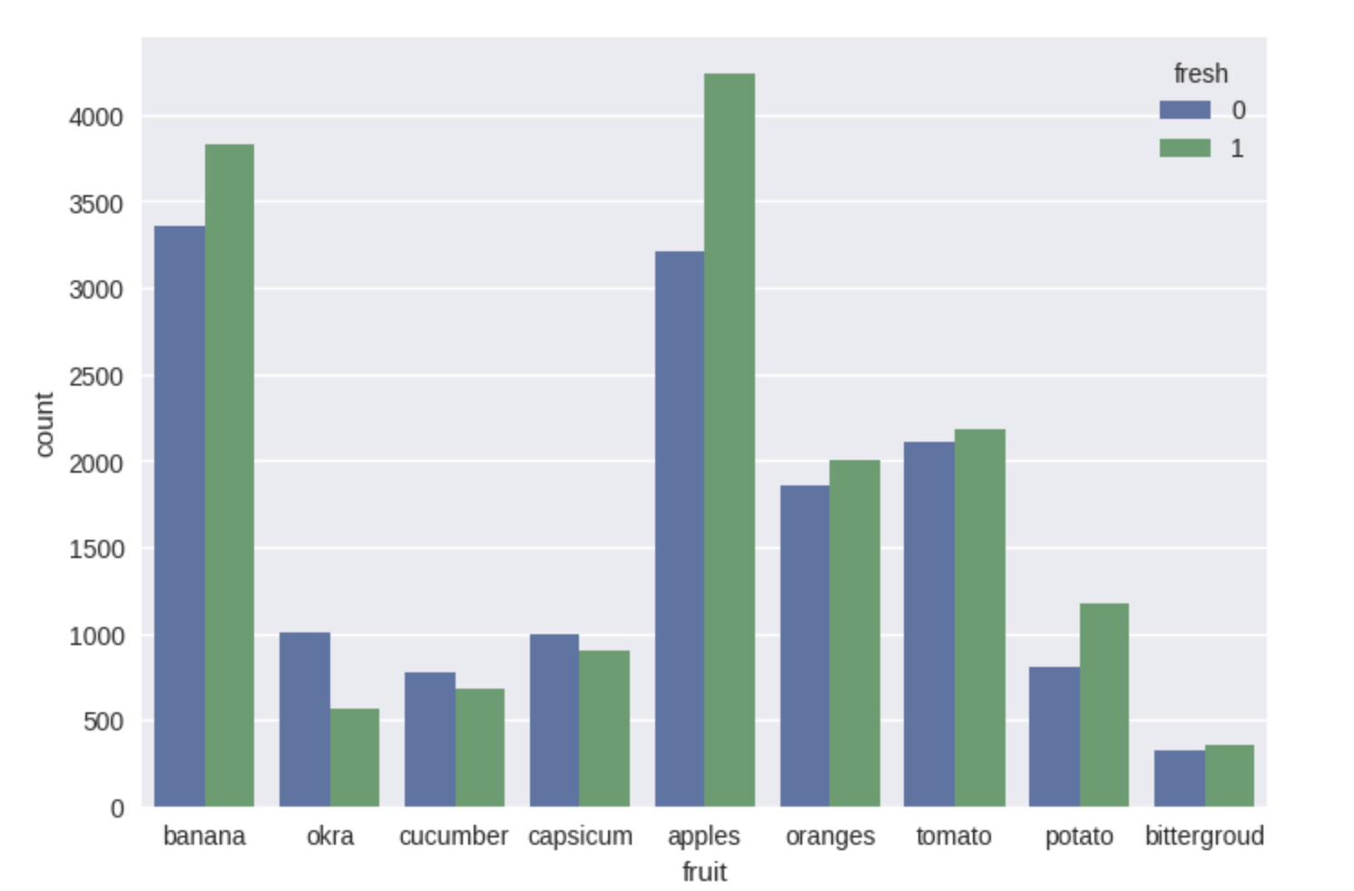
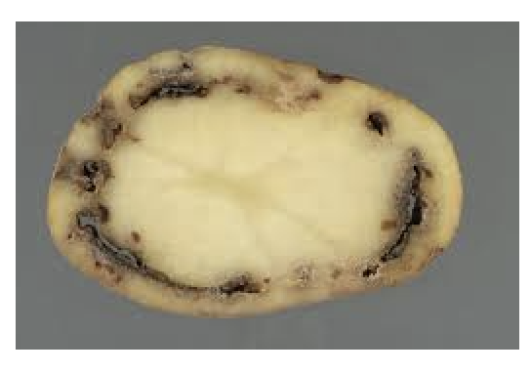
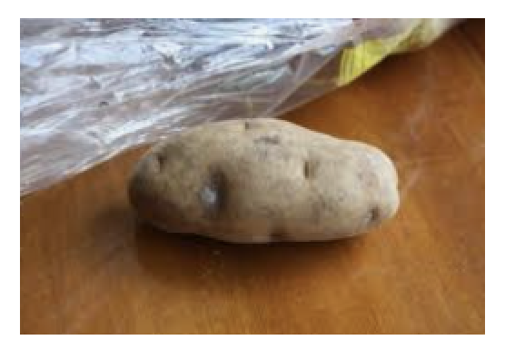
Challenges & Solutions
Data Imbalance: Some classes had fewer samples.
Confusing Visual Features:
Overripe vs. rotten often visually similar.

Slide 13
Conclusion
Fusion of YOLOv8 (object detection) and ViT (classification) significantly improves accuracy.
XGBoost effectively combines confidence scores and class probabilities.
Achieved up to 94% accuracy on fresh vs. rotten classification.
Scalable and efficient for real-time applications in smart farming and agricultural supply chains.
Modular pipeline — easy to expand or fine-tune for other fruits/vegetables.
Future Work
Testing on Real world Conditions
Try to implement on a much diverse dataset so see if it can produce improved results with more attributes.

Slide 14

We are open for Q& A.
Thank you ☺

